Slide 1
5269100.1
Beat the Clock: Q4 Planning and Ten Item “Tax To Do List”
DEBRA TAYLOR
CPA/PFS™, JD, CDFA®,
FOUNDER, WEALTH ADVISOR, LEAD TAX PLANNER
795 Franklin Avenue | Bldg. C, Suite 202 | Franklin Lakes, NJ 07417 | 201.891.1130 | taylorfinancialgroup.com
Investment advisory services offered through CWM, LLC, an SEC Registered Investment Advisor. Carson Group Partners, a division of CWM, LLC, is a nationwide partnership of advisors. None of the information contained herein is intended as tax or legal advice. Tax laws are complex and subject to change. Please consult the appropriate professional to see how the laws apply to your situation. For a comprehensive review of your personal situation, always consult with tax or legal advisors.
02439912

Slide 2
What Are We Going to Talk About Today?
Tax Report 2.0 – Updated!
Utilize Tax Returns to Expand Your Wallet Share
10 Year-End Tax Planning Strategies
Tax Shakeup 2025: Key Changes You Can’t Afford to Miss
Bonus Material
Wrap-Up and Q&A
Copyright 2024, Taylor Financial Group, LLC | For Financial Professional Use Only

Slide 3
1. Tax Report 2.0 – Updated!
Notes:
Reading from slide

Slide 4
Performing a Tax Analysis Has Never Been Easier!
In the past, performing a tax analysis was a manual process that involved gathering and analyzing data by hand. This process was time-consuming, resource-intensive, and often resulted in errors and delays.
However, with automated tools like Holistiplan, you can analyze data quickly, accurately and cost effectively! A few minutes of your time could help your clients save thousands of dollars in taxes and help you demonstrate your value as an advisor.
Therefore, you should be doing tax planning for ALL of your clients (no more excuses)!
Copyright 2024, Taylor Financial Group, LLC | For Financial Professional Use Only

Slide 5
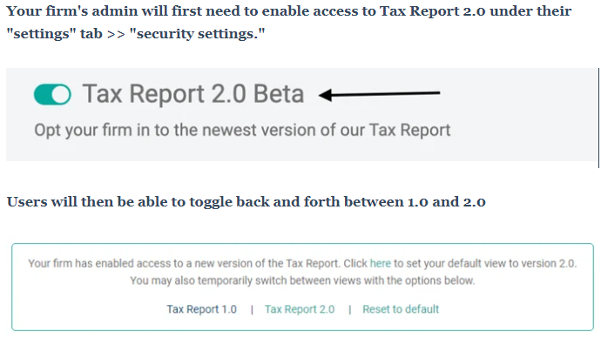
Enable the Updated Tax Report 2.0 (Beta) and Explore New Features
While Version 2.0 of the Tax Report remains in beta, you can toggle back and forth between Version 1.0 and 2.0 by clicking on the toggle switch seen near the top-right of your Tax Report.
Copyright 2024, Taylor Financial Group, LLC | For Financial Professional Use Only
Notes:
demo

Slide 6
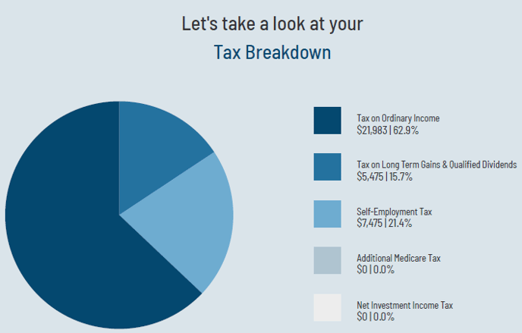
Review the Tax Breakdown in the Updated Tax Report 2.0 (Beta)
In the updated Tax Report 2.0, Holistiplan includes a chart that shows a breakdown of the total tax bill for your client's tax return.
The Tax Breakdown chart separates income tax between the two forms of taxable income, ordinary income and qualified income [long-term capital gains (LTCG) and qualified dividends], as well as other taxes like Self-Employment Tax, the Net Investment Income Tax (NIIT) and Additional Medicare Tax.
Copyright 2024, Taylor Financial Group, LLC | For Financial Professional Use Only

Slide 7
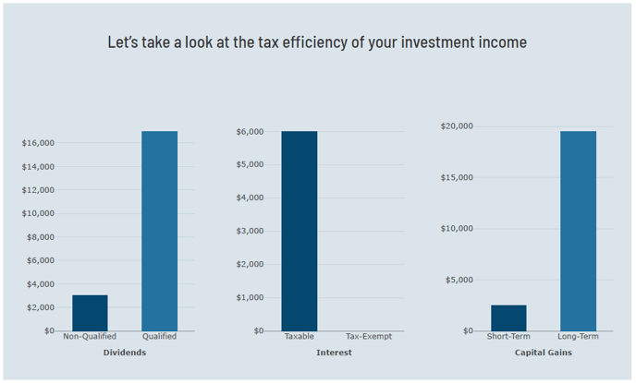
Review the Tax Efficiency of Investment Income in the Updated Tax Report 2.0 (Beta)
The Tax Report 2.0 now shows a graphical section dedicated to the tax efficiency of investment income that shows up on the return.
Users can see what portion of the clients' Ordinary (total) Dividends are qualified and therefore eligible for taxation at the more favorable long-term capital gain rates.
Users can also have a quick look at the amount of taxable vs. tax-exempt interest and how much of the net capital gains are short-term (and taxed at ordinary income rates) and long-term (and taxed at the more favorable long-term capital gains rates).
Copyright 2024, Taylor Financial Group, LLC | For Financial Professional Use Only

Slide 8
2. Utilize Tax Returns to Expand Your Wallet Share
Notes:
Reading from slide

Slide 9
Have you increased wallet share through tax planning?
Yes
No

Slide 10
We Use The Information in Our Clients’ Tax Returns For:
Roth conversions
Tax loss trading
Capital gains harvesting
IRA distribution planning
Asset location analysis
Increasing wallet share
Cash flow planning
Retirement plan review
Financial plan updates
Gifting strategies & legacy planning
Estate planning
Reviewing cash holdings
Copyright 2024, Taylor Financial Group, LLC | For Financial Professional Use Only

Slide 11
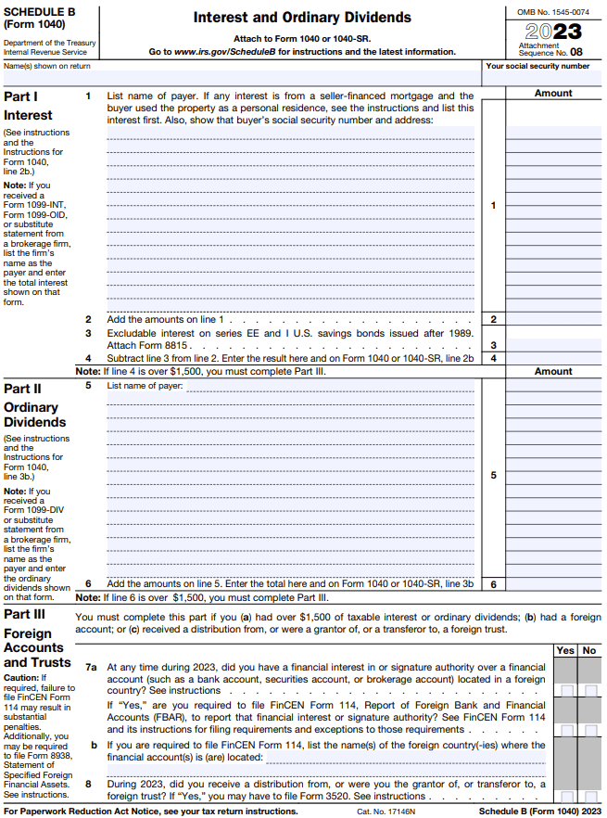
Use Schedule B in the Tax Return to Mine for Hidden Assets
To perform meaningful tax planning work, you need clients’ tax returns!
When you receive clients’ tax returns, you should review the Schedule B for other income sources.
Schedule B income sources are important because they show you other accounts and assets that you are not managing.
Copyright 2024, Taylor Financial Group, LLC | For Financial Professional Use Only

Slide 12
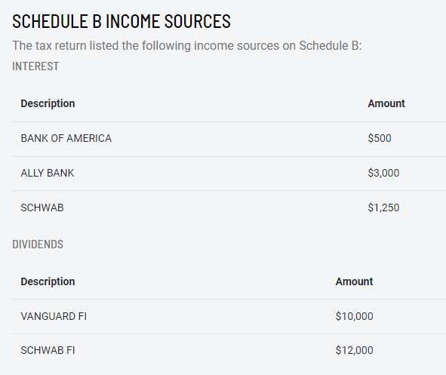
Utilize Holistiplan to Streamline Schedule B Analysis
Holistiplan is very helpful for reviewing clients’ tax returns. Just submit the tax return, and they provide you with the Tax Report. The Tax Report is essentially a summary of key points in the tax return.
Within the Holistiplan Tax Report, there is a section that shows you Schedule B income sources for each client.
We review the Schedule B income sources for each client and look for large accounts that we are not managing.
Copyright 2024, Taylor Financial Group, LLC | For Financial Professional Use Only

Slide 13
Proactively Reach Out to Individual Clients with Funds Held in Outside Accounts
Once we find clients with significant Schedule B income sources that we are not managing, we reach out to them via email.
For example, when the market dipped in July, we proactively emailed clients suggesting they “Put Cash to Work with TFG During this Market Downturn.”
Through our Wallet Share Project, we have received millions of dollars from existing clients! Money from existing clients is much easier and cheaper to get than finding new clients.
We were initially concerned that clients might feel uncomfortable by our approach. However, when asked, clients expressed gratitude for our proactivity! Everybody wins!
Copyright 2024, Taylor Financial Group, LLC | For Financial Professional Use Only

Slide 14
3. 10 Year-End Tax Planning Strategies
Notes:
Reading from slide

Slide 15
10 Year-End Tax Planning Strategies
Create tax diversification. Shift investments from pretax to taxable or Roth accounts so your clients have options when it is time to withdraw monies in retirement.
Perform Roth conversions. One of the most effective tools, partial or full Roth conversions, are used to minimize lifetime taxes and maximize lifetime wealth.
Asset location is critical. Place slower growth or income-yielding investments in tax-deferred accounts and faster growth items into Roth. Buy-and-hold investments go into taxable accounts.
Copyright 2024, Taylor Financial Group, LLC | For Financial Professional Use Only
15
Notes:
Demo RC’s

Slide 16
10 Year-End Tax Planning Strategies
Consider tax-loss trading and gain harvesting. The unsung heroes of tax planning, this is a year-round activity, not just for year-end. Consider tax-loss harvesting during market events or when selling at a gain.
Review benefits plans and strongly consider Roth 401(k)s for all future contributions. Employer benefits plans are chock full of nuggets such as Roth 401(k), after-tax accounts, daily conversions of after-tax accounts, student loan payoffs, ESPP, and deferred compensation options, among other attractive options for the investment of monies.
Maximize retirement plan contributions and examine Backdoor Roth conversions. The limit on total employer and employee contributions for 2024 is $69,000 ($76,500 with catch-up). Up to $8,000 per year into an IRA per person (with catch-up) but be aware of the pro-rata rule (taxes that are due on the conversion amount).
Copyright 2024, Taylor Financial Group, LLC | For Financial Professional Use Only

Slide 17
10 Year-End Tax Planning Strategies
Utilize Health Savings Accounts. Invest up to $8,300 if married filing jointly for 2024; consider making separate HSAs if you or your spouse is over age 55 or will be at year-end, as this will make you eligible to contribute an additional $1,000 in catch-up contributions to your HSA.
Engage in distribution planning. Alter distribution strategy by taking money from tax-deferred accounts in earlier and low tax years, taking advantage of lower tax brackets.
Appraise annuities. Annuities are making a comeback due to improved fixed income options plus tax deferral. Consider QLACs.
Estate planning/gifting. Use the annual gift tax exclusion of $18,000 ($36,000 for couples) to give assets tax-free. Leverage more aggressive charitable giving and legacy planning before year-end, where appropriate.
Copyright 2024, Taylor Financial Group, LLC | For Financial Professional Use Only

Slide 18
4. Tax Shakeup 2025: Key Changes You Can’t Afford to Miss
Notes:
Reading from slide

Slide 19
Inherited IRAs
Notes:
Reading from slide

Slide 20
6 Key Points to Remember for Inherited IRAs
The SECURE Act of 2019 introduced the 10-year rule for non-eligible beneficiaries of inherited IRAs, requiring complete depletion within 10 years of the original owner's death. Those beneficiaries are thrust into a higher tax bracket while they’re already in their peak earning years, instead of the lifetime “stretch” that was previously allowed.
To be clear, the inherited IRA still must be completely drawn down by the end of the 10th year. But now, most non-spouse beneficiaries must take RMDs AND make sure the account is $0 by the end of the 10th year.
The 10-year distribution rule (now including annual RMDs per the recent IRS guidance) is only for non-spouse beneficiaries, like children, siblings, friends, etc., and when the deceased was over the age of 73 and already taking RMDs at the time of death.
The IRS has excused missed RMDs for years 2021-2024 due to initial confusion about the requirements. However, distributions must begin in 2025, and the 10-year window is not being reset.
RMDs are calculated based on the younger of the beneficiary's age or the owner's age at their birthday in the year of death, effectively using the beneficiary's single life expectancy table.
The 10-year rule does not apply to inherited Roth IRAs, as Roth IRAs do not have RMDs. For traditional IRAs, the year of the original owner's death is considered "Year 0", and the account must be fully depleted by the end of the 10th year following death.
Copyright 2024, Taylor Financial Group, LLC | For Financial Professional Use Only

Slide 21
SECURE Act 2.0
Notes:
Reading from slide

Slide 22
SECURE Act 2.0 Expands 401(k) Automatic Enrollment
Beginning in 2025, the SECURE 2.0 Act expands automatic enrollment in retirement plans to increase participation.
If your employer offers a retirement plan, such as a 401(k) or 403(b) plan, you typically have to opt in to participate. For retirement plans starting after Dec. 31, 2024, this will no longer be the case. Instead, once employees are eligible, employers will automatically enroll them into a retirement savings plan.
The initial contribution must be at least 3% of pretax earnings but not more than 10%.
PRO TIP: Once this provision takes effect, employees will have to opt-out if they do not want to participate in their company’s retirement plan.
Copyright 2024, Taylor Financial Group, LLC | For Financial Professional Use Only
Notes:
https://www.nerdwallet.com/article/investing/secure-act

Slide 23
SECURE Act 2.0 Adds Roth Accounts as a New 401(k) Enrollment Option
SECURE Act 2.0 removed RMDs for qualified Roth contribution programs during life and equalizes treatment to Roth IRAs effective 2024.
In the past, employees with a Roth 401(k) typically had their employer contributions made into a separate, pre-tax account such as a Traditional 401(k).
With Section 604 of SECURE 2.0, employees can now choose to have their employer contributions be made into the Roth account, if offered by their employer (effective as of 2023).
PRO TIP: This does mean that the money will count as earned income and incur taxes now, but qualified distributions in retirement, similar to a Roth IRA, will be tax-free.
Copyright 2024, Taylor Financial Group, LLC | For Financial Professional Use Only
Notes:
https://www.nerdwallet.com/article/investing/secure-act

Slide 24
Higher SECURE Act 401(k) Contribution Limit
Right now, if you are 50 or older you can make catch-up contributions to your retirement plan up to certain limits ($7,500 in 2024).
SECURE 2.0 increases the catch-up contribution limits, beginning in 2025, to the greater of $10,000 or 50% more than the regular catch-up amount if you are 60, 61, 62, or 63 years old. After 2025, those amounts will be indexed for inflation.
PRO TIP: Encourage your clients to max out their 401(k) contributions, and to make catch-up contributions if they are 50 or older.
Copyright 2024, Taylor Financial Group, LLC | For Financial Professional Use Only

Slide 25
Higher Retirement Plan Catch-Up Limits
401(k) Contribution Limit Example – 2025 Projection
Copyright 2024, Taylor Financial Group, LLC | For Financial Professional Use Only

Slide 26
Catch-Up Elective Deferrals Limited to Roth Contributions for Some Employees
Starting in 2026, there are no deductible catch-up contributions from employees with wages from the employer exceeding $145,000. Instead, contributions are required to be made to a Roth 401(k).
PRO TIP: Encourage your clients to leverage the Roth 401(k) catch-up contributions, and to adjust for additional taxes.
Copyright 2024, Taylor Financial Group, LLC | For Financial Professional Use Only

Slide 27
Sunset of the TCJA
Notes:
Reading from slide

Slide 28
Beware the TCJA’s Sunset
Sunsets are provisions of the tax code that expire at a specified date
Take the 2017 Tax Cuts and Jobs Act (TCJA): many provisions that benefit individual taxpayers are due to expire, or “sunset,” at the end of 2025.
As a result of the TCJA’s “Sunset,” Jan. 1, 2026, might mean the return of several unwelcome provisions…
For individual taxpayers, the top individual, estate and trust income tax bracket goes back up to 39.6% from the current rate of 37%.
Raising of rates: From Jan 1, 2018, to Jan. 1, 2026, the TCJA instituted seven tax rates of: 10%, 12%, 22%, 24%, 32%, 35% and 37%. Come Jan. 1, 2026, the seven rates will return to pre-Act Internal Revenue Code levels for individuals filing a tax return: 10%, 15%, 25%, 28%, 33%, 35% and 39.6%.
Sharp decrease in the lifetime exclusion / estate tax, from ~$13.61M in 2025 to an est. $6.5M (adj. for inflation) in 2026.
Copyright 2024, Taylor Financial Group, LLC | For Financial Professional Use Only
Notes:
According to Vanguard, financial advisors need to focus on the complex, creative, and human parts of the financial advice industry to remain profitable and grow. Some examples of these tasks include: applying knowledge, strategizing, thinking creatively, solving problems, judging quality, developing teams, maintaining relationships, and assisting and caring for others.
Thankfully, many of these complex and/or human tasks are key components of the financial advisory business when an advisor is providing comprehensive advice across all spectrums. Some “advanced” tasks financial advisors perform include: applying years of personal and professional knowledge when creating financial plans for clients, strategizing to ensure clients’ financial health, thinking creatively to solve clients’ financial problems, and judging the quality of clients’ financial, estate and tax plans. T
think about how many times you are called upon to work with clients on debt reduction strategies or how best to save for college retirement. Deciding whether and how a client should take out a loan, open a Section 529 Plan or tap into home equity to pay for college is but one example of assistance that is of a higher order.
Constructing retirement plans, estate plans, tax plans, cash flow and budget plans (and much more) requires knowledge across several disciplines and is not easily solved by an algorithm. Indeed, as we have discussed several times in this space, providing strategic advice regarding the New Tax Act is the most recent opportunity to add value. A financial advisor – if she does it right – can take great pride in completing advanced tasks for clients that machines cannot replicate.
Question: Are most of your firm’s services considered “Advanced?” Or are you more focused on “Repetitive” tasks such as processing paperwork?

Slide 29
Lifetime Exclusion/Estate Tax Could Be Next to Sunset
Year of Death | Gift and Estate Tax Basic Exclusion Amount Per Individual
2011 | $5,000,000
2012 | $5,120,000
2013 | $5,250,000
2014 | $5,340,000
2015 | $5,430,000
2016 | $5,450,000
2017 | $5,490,000
2018 | $11,180,000
2019 | $11,400,000
2020 | $11,580,000
2021 | $11,700,000
2022 | $12,060,000
2023 | $12,920,000
2024, 2025 | $13,610,000 (2024) (2025 TBD)
2026 | $5,490,000 (to be adj. for inflation)
Effective in 2018, the TCJA doubled the estate and gift tax exemption to $11.2 million for single filers, $22.4 million for couples, and continued to index the exemption levels for inflation.
In 2024, the federal estate and gift tax threshold increased to $13.61 million per individual, $27.22 million for couples.
In 2026, the estate and gift exemption will revert back to pre-TCJA levels, effectively reduced by half, and expected to be in the ballpark of $6.5 million per individual or $13 million for a married couple once adjusted for inflation, according to RBC.
Source: Internal Revenue Service
Copyright 2024, Taylor Financial Group, LLC | For Financial Professional Use Only
Notes:
According to Vanguard, financial advisors need to focus on the complex, creative, and human parts of the financial advice industry to remain profitable and grow. Some examples of these tasks include: applying knowledge, strategizing, thinking creatively, solving problems, judging quality, developing teams, maintaining relationships, and assisting and caring for others.
Thankfully, many of these complex and/or human tasks are key components of the financial advisory business when an advisor is providing comprehensive advice across all spectrums. Some “advanced” tasks financial advisors perform include: applying years of personal and professional knowledge when creating financial plans for clients, strategizing to ensure clients’ financial health, thinking creatively to solve clients’ financial problems, and judging the quality of clients’ financial, estate and tax plans. T
think about how many times you are called upon to work with clients on debt reduction strategies or how best to save for college retirement. Deciding whether and how a client should take out a loan, open a Section 529 Plan or tap into home equity to pay for college is but one example of assistance that is of a higher order.
Constructing retirement plans, estate plans, tax plans, cash flow and budget plans (and much more) requires knowledge across several disciplines and is not easily solved by an algorithm. Indeed, as we have discussed several times in this space, providing strategic advice regarding the New Tax Act is the most recent opportunity to add value. A financial advisor – if she does it right – can take great pride in completing advanced tasks for clients that machines cannot replicate.
Question: Are most of your firm’s services considered “Advanced?” Or are you more focused on “Repetitive” tasks such as processing paperwork?

Slide 30
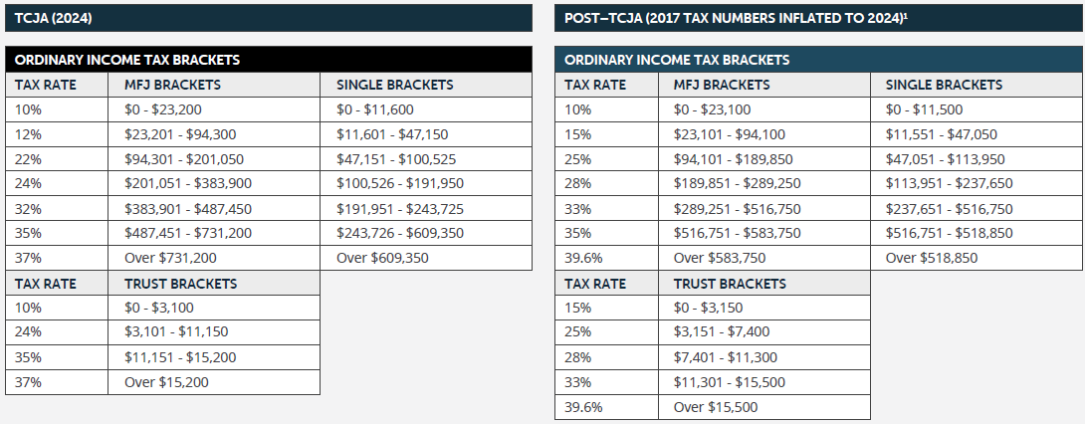
1. Marginal Brackets May Become Less Favorable
Should no legislation be passed before the end of 2025, we could see tax brackets reverting back to the higher, pre-TCJA rate!
Source: FP Pathfinder
Copyright 2024, Taylor Financial Group, LLC | For Financial Professional Use Only

Slide 31
2. Standard Deduction May Decrease
The TCJA nearly doubled the standard deduction, making it more advantageous for many taxpayers to take the standard deduction rather than itemizing deductions.
Source: FP Pathfinder
Copyright 2024, Taylor Financial Group, LLC | For Financial Professional Use Only

Slide 32
3. Tax Credits May Become Limited
Certain tax credits changed after the TCJA was enacted. Here are some tax credit provisions that could expire in 2025.
Child Tax Credit: Current at $2,000 per child. Prior to the TCJA, the credit was $1,000 per child. Single parents who earned more than $75,000 could only partially claim it. For married couples, this amount was $110,000. The TCJA increased these amounts to $200,000 and $400,000 respectively.
Credit for Other Dependents: Taxpayers can claim $500 for each dependent that doesn’t qualify for the child tax credit.
Copyright 2024, Taylor Financial Group, LLC | For Financial Professional Use Only

Slide 33
4. Tax Deductions May Return
If the TCJA is not extended or made permanent, there are several tax deductions that will revert to pre-TCJA figures.
SALT Deduction: Currently capped at $10,000. However, a new proposal is aiming to raise this limit to $20,000 for married couples filing jointly who earn less than $500,000 for tax year 2023. Prior to the TCJA, there was no limit for the SALT deduction.
Mortgage Interest Deduction: Prior to the TCJA, homeowners could deduct interest paid on mortgages of up to $1,000,000, or $500,000 for married couples filing separately. Under the TCJA, anyone who takes out a mortgage between December 15, 2017, and December 31, 2025, can only deduct interest paid on the first $750,000. This amount reduces to $375,000 for married taxpayers filing separately.
Charitable Giving Deduction: You can currently deduct charitable contributions, up to 60% of your adjusted gross income. Once the TCJA sunsets, the cap will be 50% of your AGI.
Medical Expense Deduction: Currently capped at 7.5% of adjusted gross income. Prior to the TCJA, the cap was 10% of AGI.
Miscellaneous Deductions: The Tax Cuts and Jobs Act eliminated several miscellaneous deductions that were previously available. These include the cost of tax preparation, unreimbursed work expenses, financial advisory fees, moving expenses, and others.
Copyright 2024, Taylor Financial Group, LLC | For Financial Professional Use Only

Slide 34
5. Estate Gift Tax Exemption May Be Halved
The estate and gift tax exemption is currently capped at $13.61 million per lifetime for individual filers and $27.22 million for married couples filing jointly (2024).
If the TCJA provisions expire at the end of 2025, the inflation adjusted estate tax exemption is anticipated to land at around $6.5 million effective January 1, 2026 (essentially cutting the current exemption in half)!
With such a significant change on the horizon, you should be reaching out to clients who may be at risk (net worth over ~$6M (Single) or ~$13M (MFJ)) and review their estate and start planning now.
Copyright 2024, Taylor Financial Group, LLC | For Financial Professional Use Only
Notes:
All of this adds up to a real threat potentially to families who have about $6M or more in assets, as there is a lot at risk. In addition, much of this estate planning requires years of advance planning, and often this legislation is passed with very little warning and can be retroactive if Congress so chooses.
Congress could cut the current exemption in half, going down to about $6 million in a lifetime exemption. Anybody worth around that amount or more should be focused on planning to minimize potential taxes. For a couple, they should be concerned if they are worth around $ 10-12 million.
Tax chaos is not going away and Washington is not your friend. But, most important, tax planning is typically most effective when it is performed over a course of years. The very wealthy already know that, and now it is time for those who have accumulated wealth in the last ten or twenty years to heed that same lesson and begin their planning now.

Slide 35
Four Estate Planning Moves to Make in Case the TCJA Sunsets
(Or in Anticipation)
Qualified Personal Residence Trust (QPRT) - A QPRT freezes the value of the home at the time the trust is created, which can shield future appreciation from estate taxes. However, if the grantor dies before the trust terminates, the property will revert to his or her estate for tax purposes.
Spousal Lifetime Access Trust (SLAT) - SLATs allow couples to transfer wealth to an irrevocable trust, while maintaining control and access to their money. The trusts provide money for the beneficiary spouse, while excluding assets from the grantor spouse’s estate.
Charitable Remainder Trust - These irrevocable trusts allow donors to give assets to charity and still receive income for the rest of their life, with remaining assets going to the charity.
Grantor Retained Annuity Trust (GRAT) - In a GRAT, a donor transfers money to an irrevocable trust, while eventually taking back the principal, plus interest. Any gains on the principal can stay in the trust. When the trust’s term ends, beneficiaries inherit the remaining assets free of estate and gift taxes.
Copyright 2024, Taylor Financial Group, LLC | For Financial Professional Use Only

Slide 36
Be Proactive & Have Conversations Now!
As the expiration date approaches, there is likely to be increased debate over the fate of the TCJA provisions. Lawmakers may consider various options, including extending certain provisions, making them permanent, or implementing alternative reforms to the tax code.
Remember, many provisions are “use it or lose it.”
While the future of these provisions remain uncertain, it is your job as an advisor to educate clients and implement strategies now to mitigate any potential adverse effects and optimize their financial strategies in the years to come.
Copyright 2024, Taylor Financial Group, LLC | For Financial Professional Use Only
Notes:
Congress could cut the current exemption in half, going down to about $6 million in a lifetime exemption. Anybody worth around that amount or more should be focused on planning to minimize potential taxes. For a couple, they should be concerned if they are worth around $ 10-12 million.
Tax chaos is not going away and Washington is not your friend. But, most important, tax planning is typically most effective when it is performed over a course of years. The very wealthy already know that, and now it is time for those who have accumulated wealth in the last ten or twenty years to heed that same lesson and begin their planning now.

Slide 37
5. Bonus Material

Slide 38
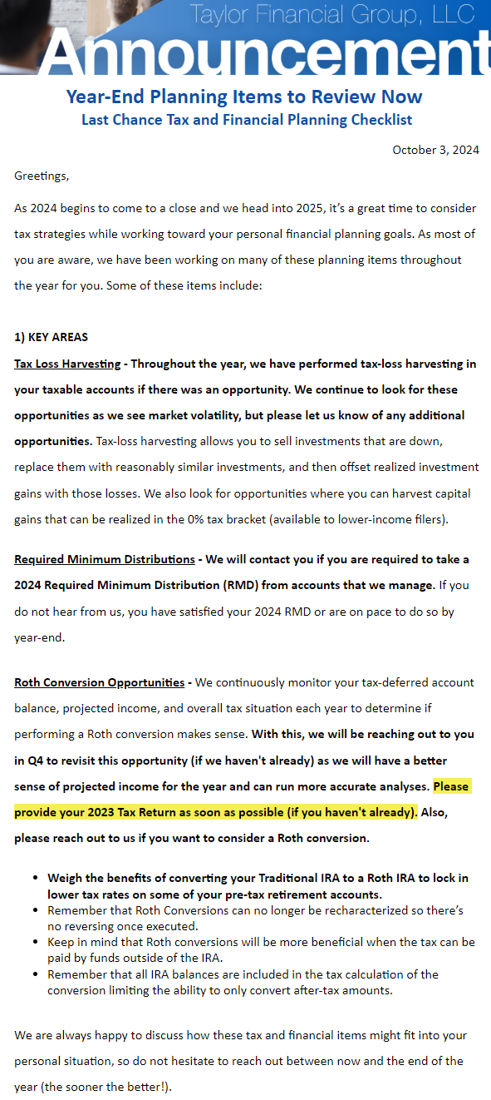
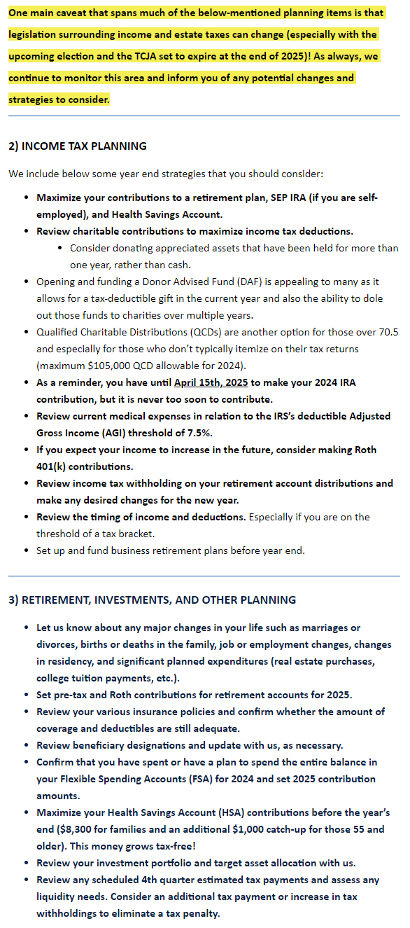
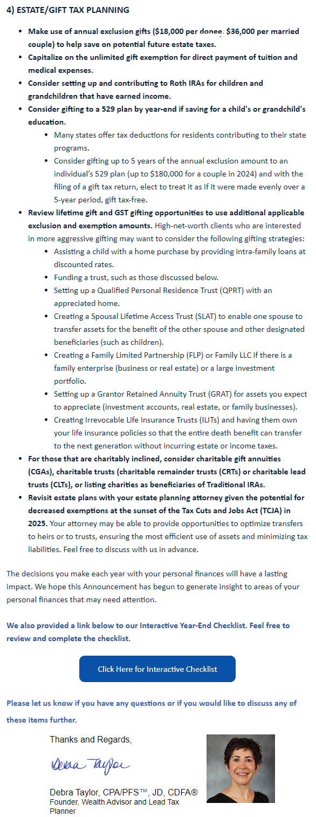
Bonus Material
October & November – Year End Planning Items Announcement
Copyright 2024, Taylor Financial Group, LLC | For Financial Professional Use Only
Notes:
New!

Slide 39
6. Wrap Up & Q&A

Slide 40
SIGN UP TODAY!
USE CODE Debbietaylor2024 for 10% off in 2024.

Slide 41
Fortune Favors the Bold

Slide 42
Disclosures
Investment advisory services offered through CWM, LLC, an SEC Registered Investment Advisor. Carson Group Partners, a division of CWM, LLC, is a nationwide partnership of advisors. None of the information contained herein is intended as tax or legal advice. Tax laws are complex and subject to change. Please consult the appropriate professional to see how the laws apply to your situation. For a comprehensive review of your personal situation, always consult with tax or legal advisors.
Investors cannot invest directly in indexes. The performance of any index is not indicative of the performance of any investment and does not take into account the effects of inflation and the fees and expenses associated with investing.
Past performance is not an indication or guarantee of future results.
Converting from a traditional IRA to a Roth IRA is a taxable event.
A Diversified portfolio does not assure a profit or protect against loss in a declining market.
S&P 500 -A capitalization-weighted index of 500 stocks designed to measure performance of the broad domestic economy through changes in the aggregate market value of 500 stocks representing all major industries.
Russell 2000 Index - The Russell 2000 Index measures the performance of the small-cap segment of the U.S. equity universe and is a subset of the Russell 3000 Index representing approximately 10% of the total market capitalization of that index. It includes approximately 2000 of the smallest securities based on a combination of their market cap and current index membership.
The Dow Jones Industrial Average is a price-weighted average of 30 U.S. blue-chip stocks traded on the New York Stock Exchange and NASDAQ. The index covers all industries except transportation, real estate and utilities.
The NASDAQ Composite Index includes all domestic and international based common type stocks listed on The NASDAQ Stock Market. The NASDAQ Composite Index includes over 2,500 companies, spanning all 11 sector groups.
Some IRAs have contribution limitations and tax consequences for early withdrawals. For complete details, consult your tax advisor or attorney. Distributions from traditional IRA's and employer sponsored retirement plans are taxed as ordinary income and, if taken prior to reaching age 59 ½, may be subject to an additional 10% IRS tax penalty. Converting from a traditional IRA to a Roth IRA is a taxable event. A Roth IRA offers tax free withdrawals on taxable contributions. To qualify for the tax-free and penalty-free withdrawal or earnings, a Roth IRA must be in place for at least five tax years, and the distribution must take place after age 59 ½ or due to death, disability, or a first-time home purchase (up to a $10,000 lifetime maximum). Depending on state law, Roth IRA distributions may be subject to state taxes.
All Investing involves risk, including the possible loss of principal. There is no assurance that any investment strategy will be successful.
Additional risks are associated with international investing, such as currency fluctuations, political and economic stability, and differences in accounting standards.
MSCI Emerging Markets- Designed to measure equity market performance in global emerging markets. It is a float-adjusted market capitalization index.
MSC/ EAFE index is designed to measure the equity market performance of developed markets (Europe, Australasia, Far East) Excluding the
U.S and Canada. The index is market capitalization weighted.
Investing in mutual funds is subject to risk and loss of principal. There is no assurance or certainty that any investment strategy will be successful in meeting its objectives.
A Roth IRA offers tax free withdrawals on taxable contributions. To qualify for the tax-free and penalty free withdrawal or earnings, a Roth IRA must be in place for at least five tax years, and the distribution must take place after age 59 ½ or due to death, disability, or a first-time home purchase (up to a $10,000 lifetime maximum). Depending on state law, Roth IRA distributions may be subject to state taxes.
Exchange-traded funds and mutual funds are sold only by prospectus. Investors should consider the investment objectives, risks and charges and expenses of the funds carefully before investing. The prospectus contains this and other information about the funds. Contact Debra Taylor at dtaylor@taylorfinanicalgroup.com or 201-891-1979 to obtain a prospectus, which should be read carefully before investing or sending money.
The MSC/ All-Country World Ex-U.S. Index is a free float-adjusted market capitalization weighted index that is designed to measure the equity market performance of developed and emerging markets, but excludes the United States. The SMC/ ACWJ consists of 45 country indexes comprising 22 developed and 23 emerging market country indexes. The developed country indexes include: Australia, Austria, Belgium, Canada, Denmark, Finland, France, Germany, Hong Kong, Ireland, Israel, Italy, Japan, Netherlands, New Zealand, Norway, Portugal, Singapore, Spain, Sweden, Switzerland, and the United Kingdom. The emerging market country indexes included are: Brazil, Chile, China, Colombia, Czech Republic, Egypt, Greece, Hungary, India, Indonesia, Korea, Malaysia, Mexico, Peru, Philippines, Poland, Qatar, Russia, South Africa, Taiwan, Thailand, Turkey and United Arab Emirates.

